Slide 1
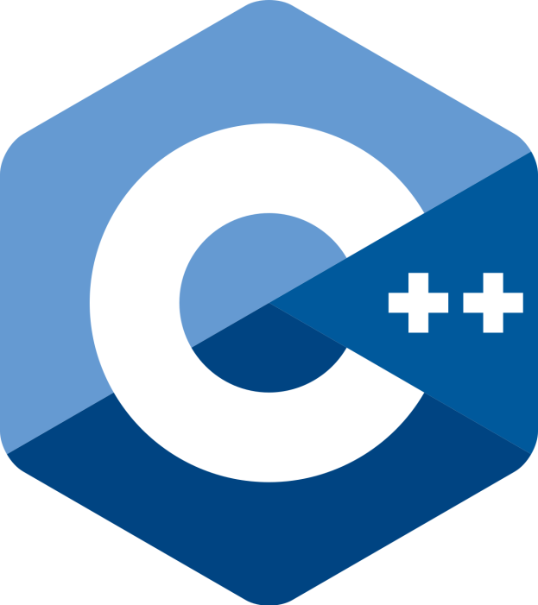
Object Oriented Programming using

Slide 2
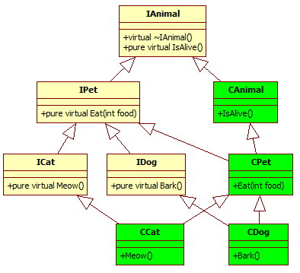
Programming Exercise 1

Slide 3
Programming Exercise 2
Function Overriding:
Create class calculation which have 2 data members num1,num2 and one pure virtual function result
Create classes addition,subtraction,multiplication and define result in them

Slide 4
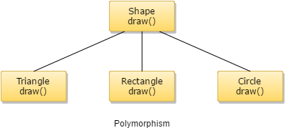
Function Overloading

Slide 5
How to provide an implementation of virtual function inside a non-virtual function. Give Example also.

Slide 6
Run-time polymorphism
Create a class Base1 and its two non-virtual function f1 and f2 and one virtual function f3.
Create a class Base 2 and its two non virtual function f1 and f3, one virtual function f2.
Create a class derived from Base1 and Base 2. define function f1, f2 and f3.
Access all the functions

Slide 7
Virtual Destructor
Create a class CAR which will have one virtual destructor
Create a class ford derived from CAR which will also have one virtual destructor
Create a class Toyota derived from class Car and have a simple destructor
Create a class Fortuner derived from Toyota have a virtual destructor

Slide 8
Function overloading
Create a class Cat having a data member variable num1. create a constructor of class Cat which will take the value for num1.
Create a member function fun() with const and compute the square of num1
Create a member function fun() and return twice the value of num1.
In main function call both of the member functions.

Slide 9
Operator Overloading
Unary operator overloading with ++ and –-
Write a C++ program that overloads the unary ++ operator to increment each element of the given one dimensional array by ‘1’?
Binary Operator overloading with +

